Slide 1
Siyan Liu
Movie App By
Miaomiao Hou
Miaomiao Hou

Slide 2
1
Topic and Dataset
Movie development
2
Analysis: Q1
The development of movies these years
catalogue
3
Analysis: Q2
Which country is the most competitive
4
APP demo
A demo of our movie app

Slide 3
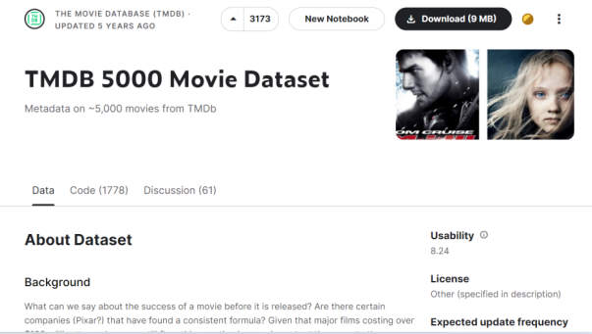
Topic and Dataset
TMDB 5000 Movie Dataset
国外研究
We chose the TMDB 5000 Movie Dataset and made a
movie app, which can show the information about movie development.
您的内容打在这里，或者通过复制您的文本并悬着只保留文本。您的内容打在这里，或者通过复制您的文本并悬着只保留文本。您的内容打在这里，或者通过复制您的文本并悬着只保留文本。
国外研究
您的内容打在这里，或者通过复制您的文本并悬着只保留文本。您的内容打在这里，或者通过复制您的文本并悬着只保留文本。您的内容打在这里，或者通过复制您的文本并悬着只保留文本。
https://www.kaggle.com/datasets/tmdb/tmdb-movie-metadata

Slide 4
01
Part one
Topic and Dataset

Slide 5
02
Part two
Analysis: Q1
The development of movies these years

Slide 6
Analysis: Q1
Analysis: Q1
Because of the number of movies in 2017 is too small, so it can't be used as a reference for the average vote
All in all,the quantity of movies is declining and the average vote is relatively stable.Occasionaly,there are some ups and downs.

Slide 7
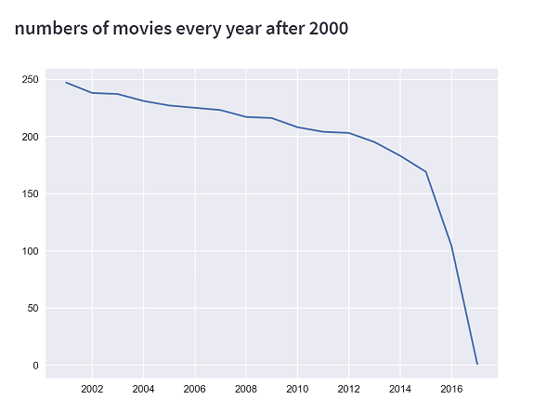
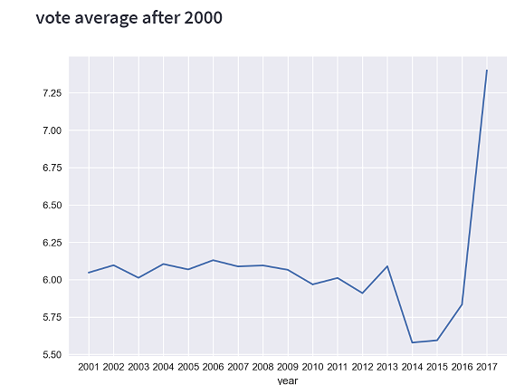
Analysis: Q1
The average vote of movies after 2000
In this picture,the vote average decreases sharply in 2014, which reached the lowest point and rises suddenly in 2017
The quantity of movies after 2000
We find that the quantity of movies is declining.It decreases sharply after 2015

Slide 8
03
Part three
Analysis: Q2
Which country is the most competitive

Slide 9
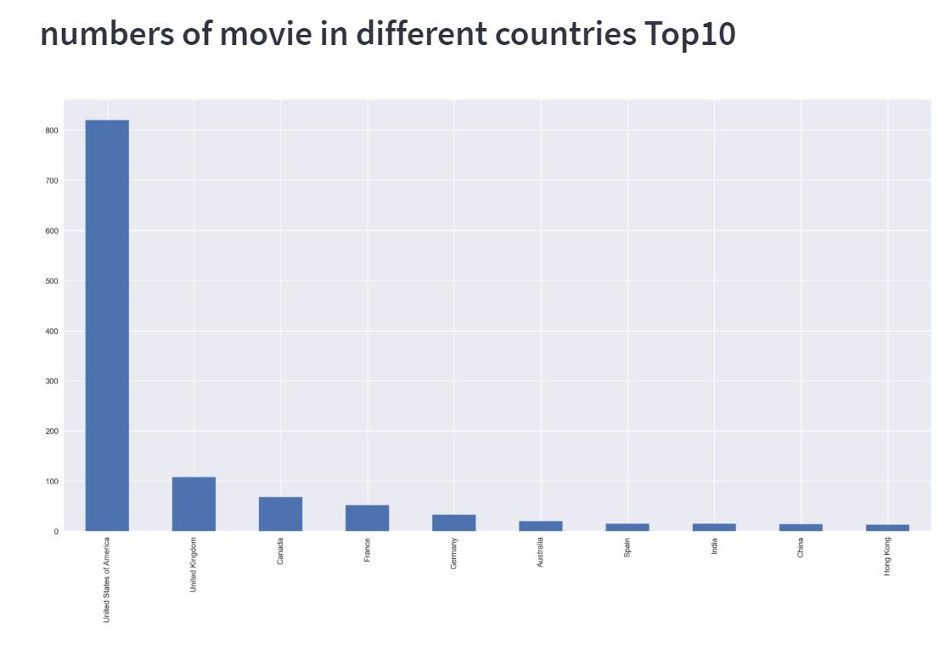
Analysis: Q2
Which country is the most competitive?

Slide 10
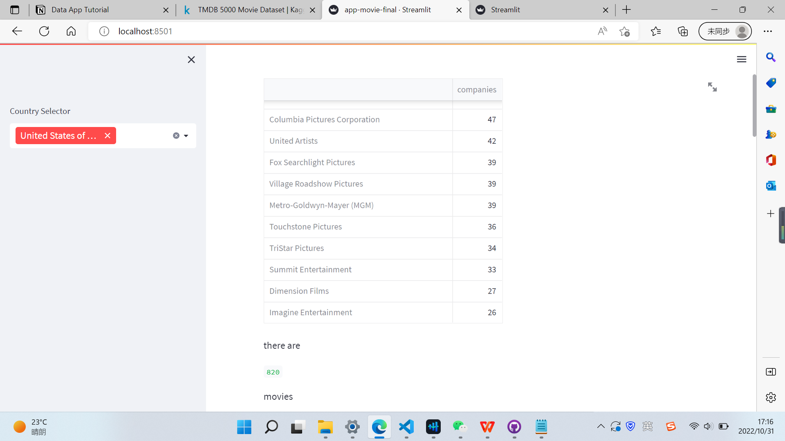
Analysis: Q2
Which country is the most competitive?

Slide 11
Analysis: Q2
Which country is the most competitive?

Slide 12
04
Part four
APP demo

Slide 13
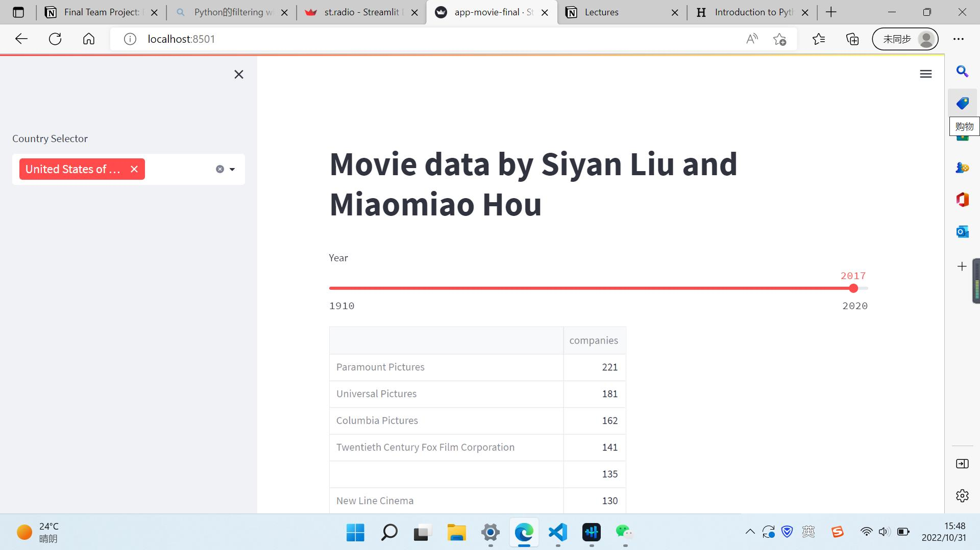

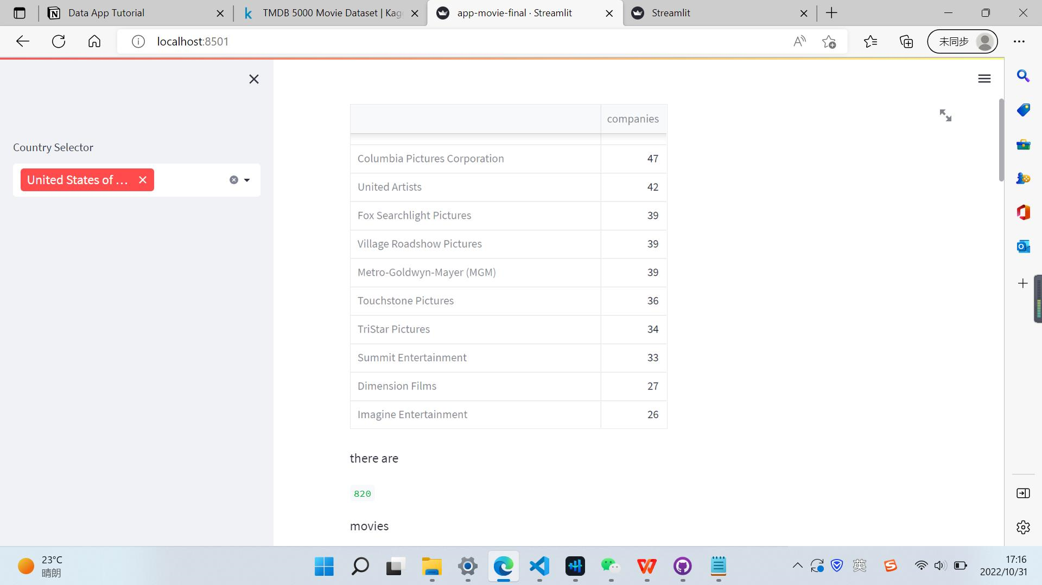
chart
APP demo

Slide 14
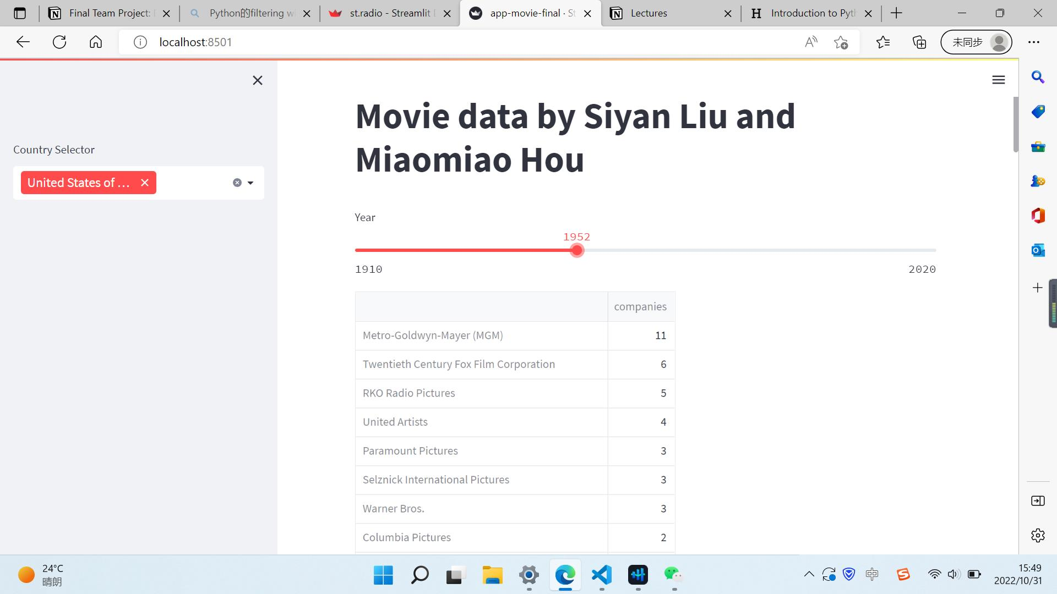
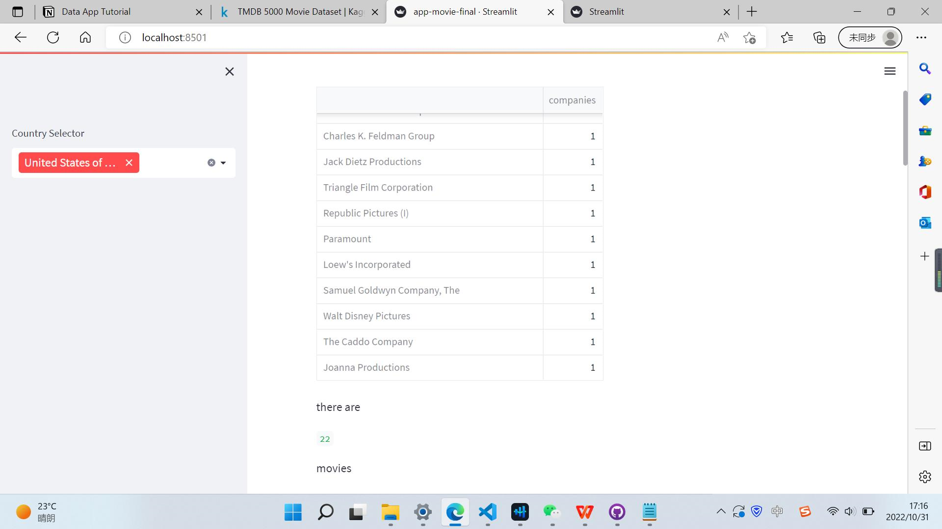
chart
APP demo

Slide 15
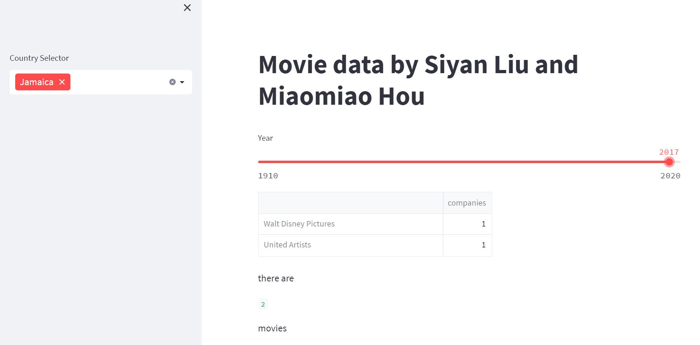
chart
APP demo

Slide 16
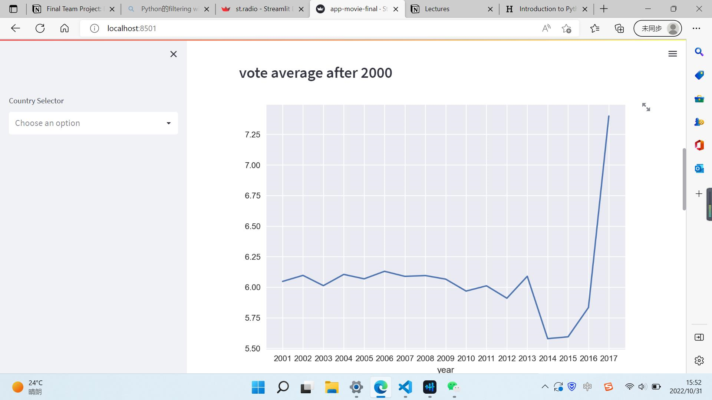
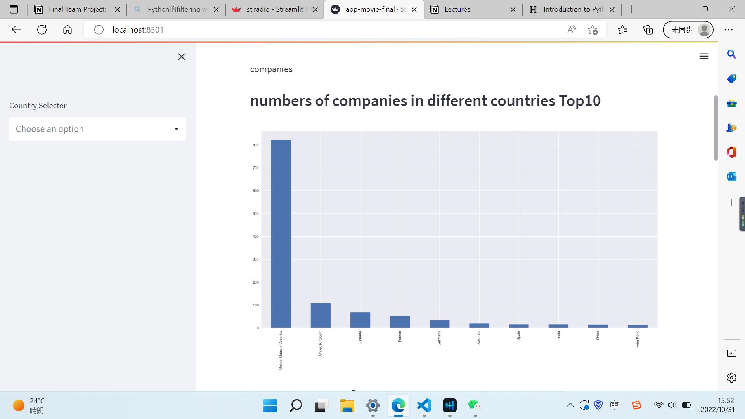
chart
APP demo

Slide 17
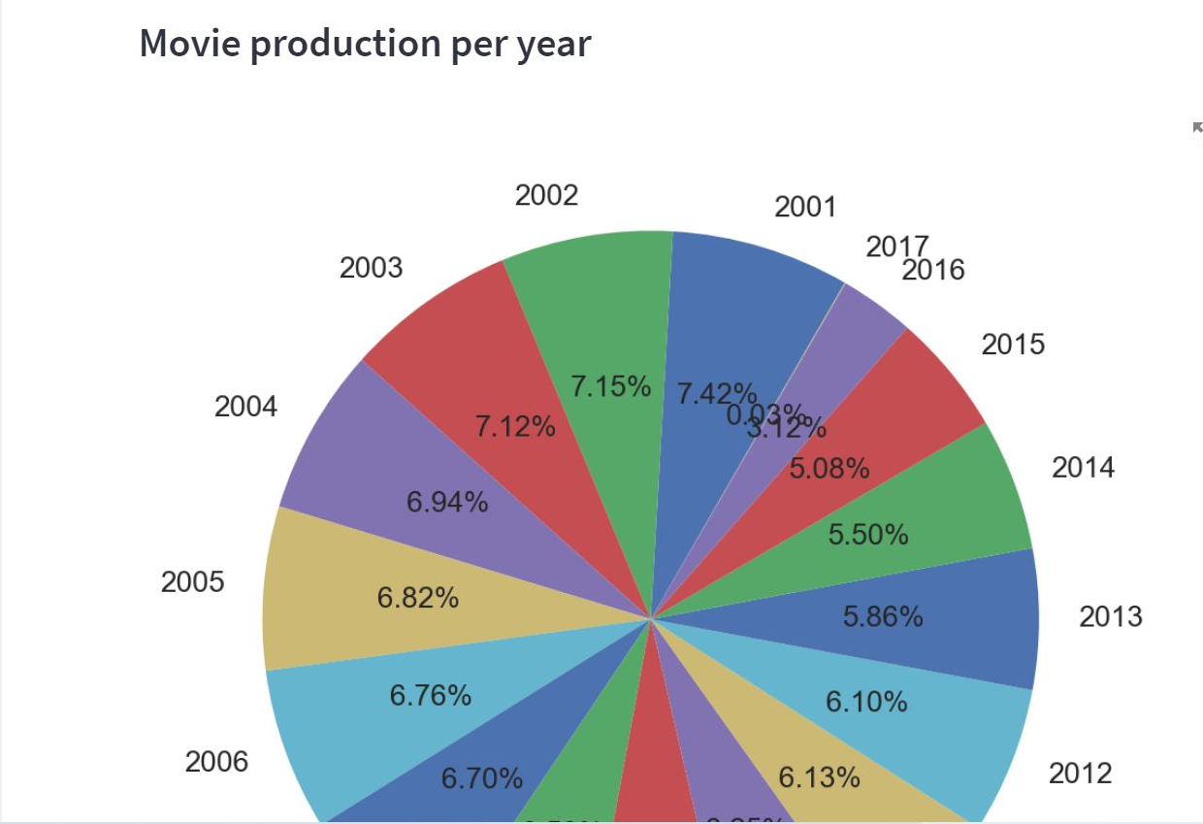
chart
APP demo

Slide 18
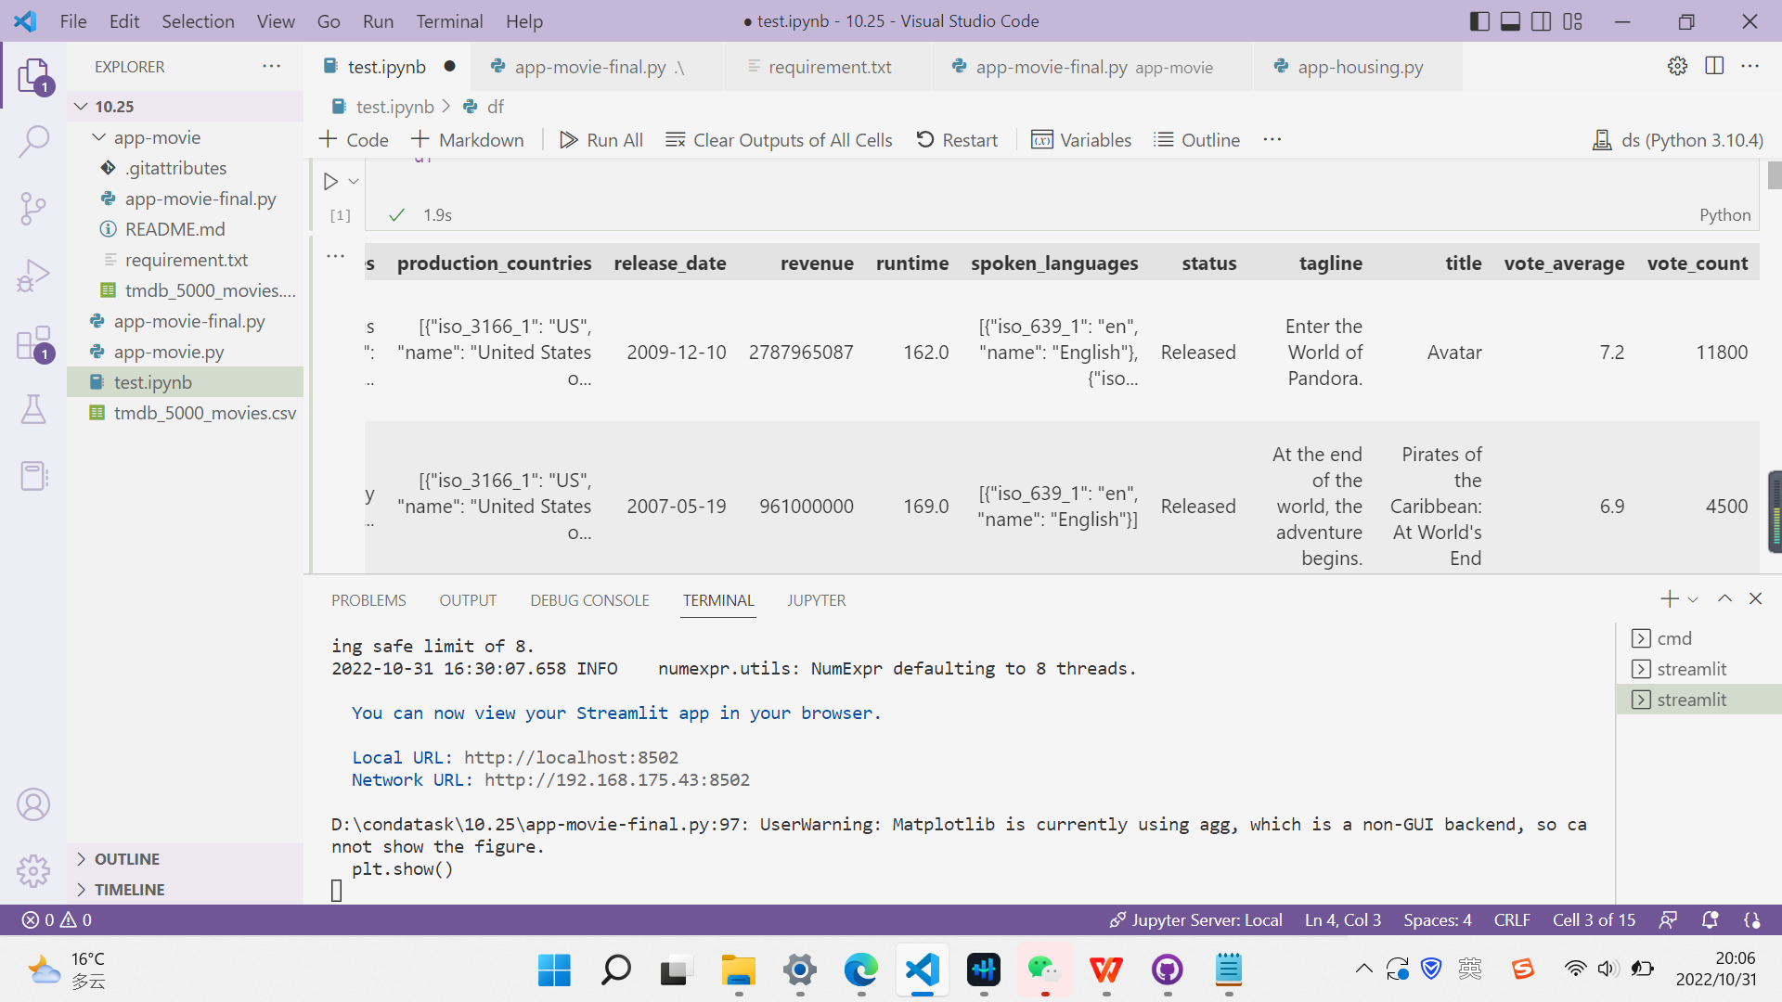
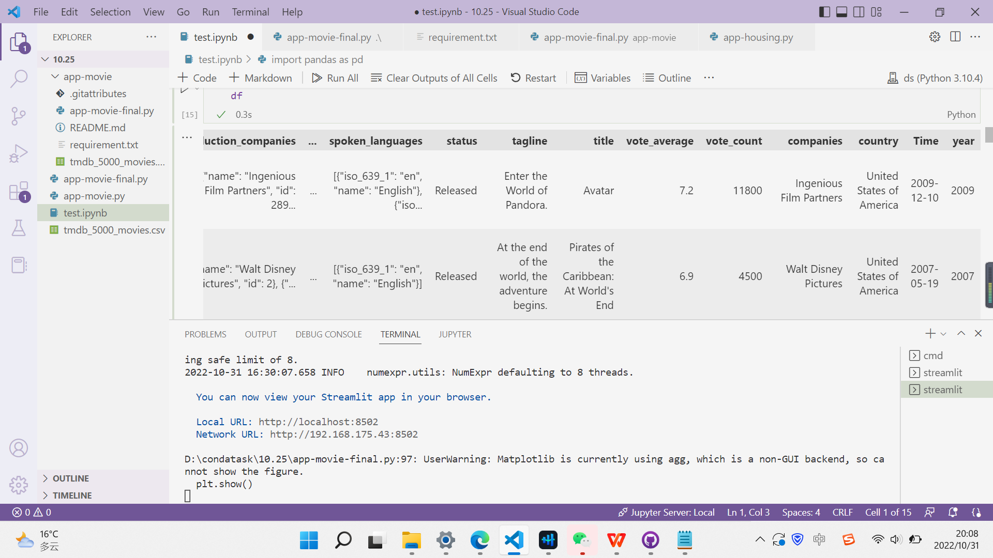
APP demo

Slide 19
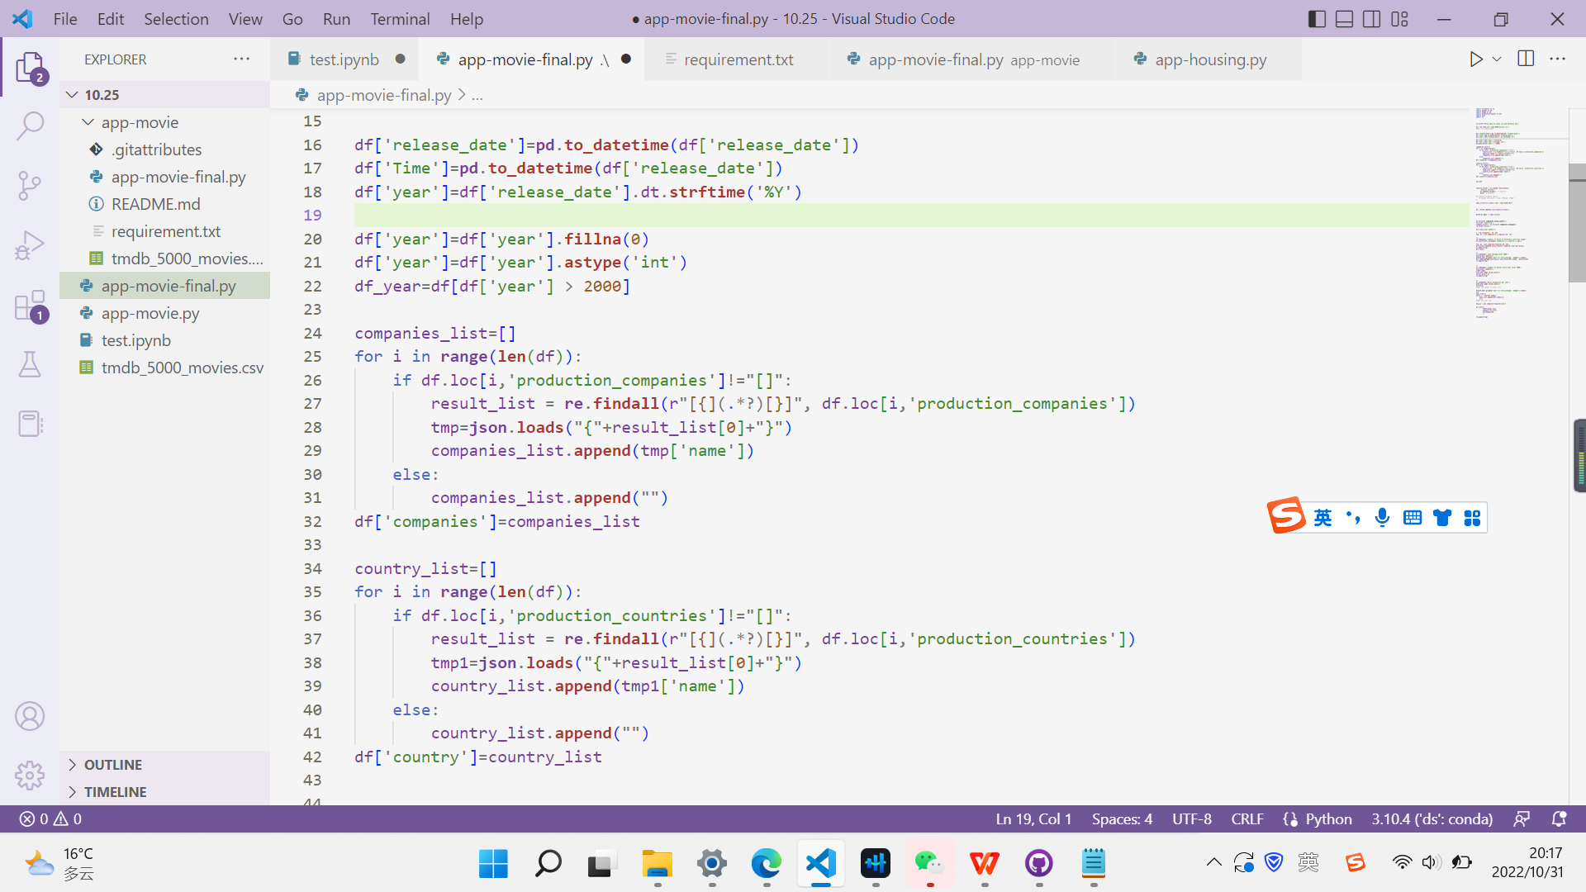
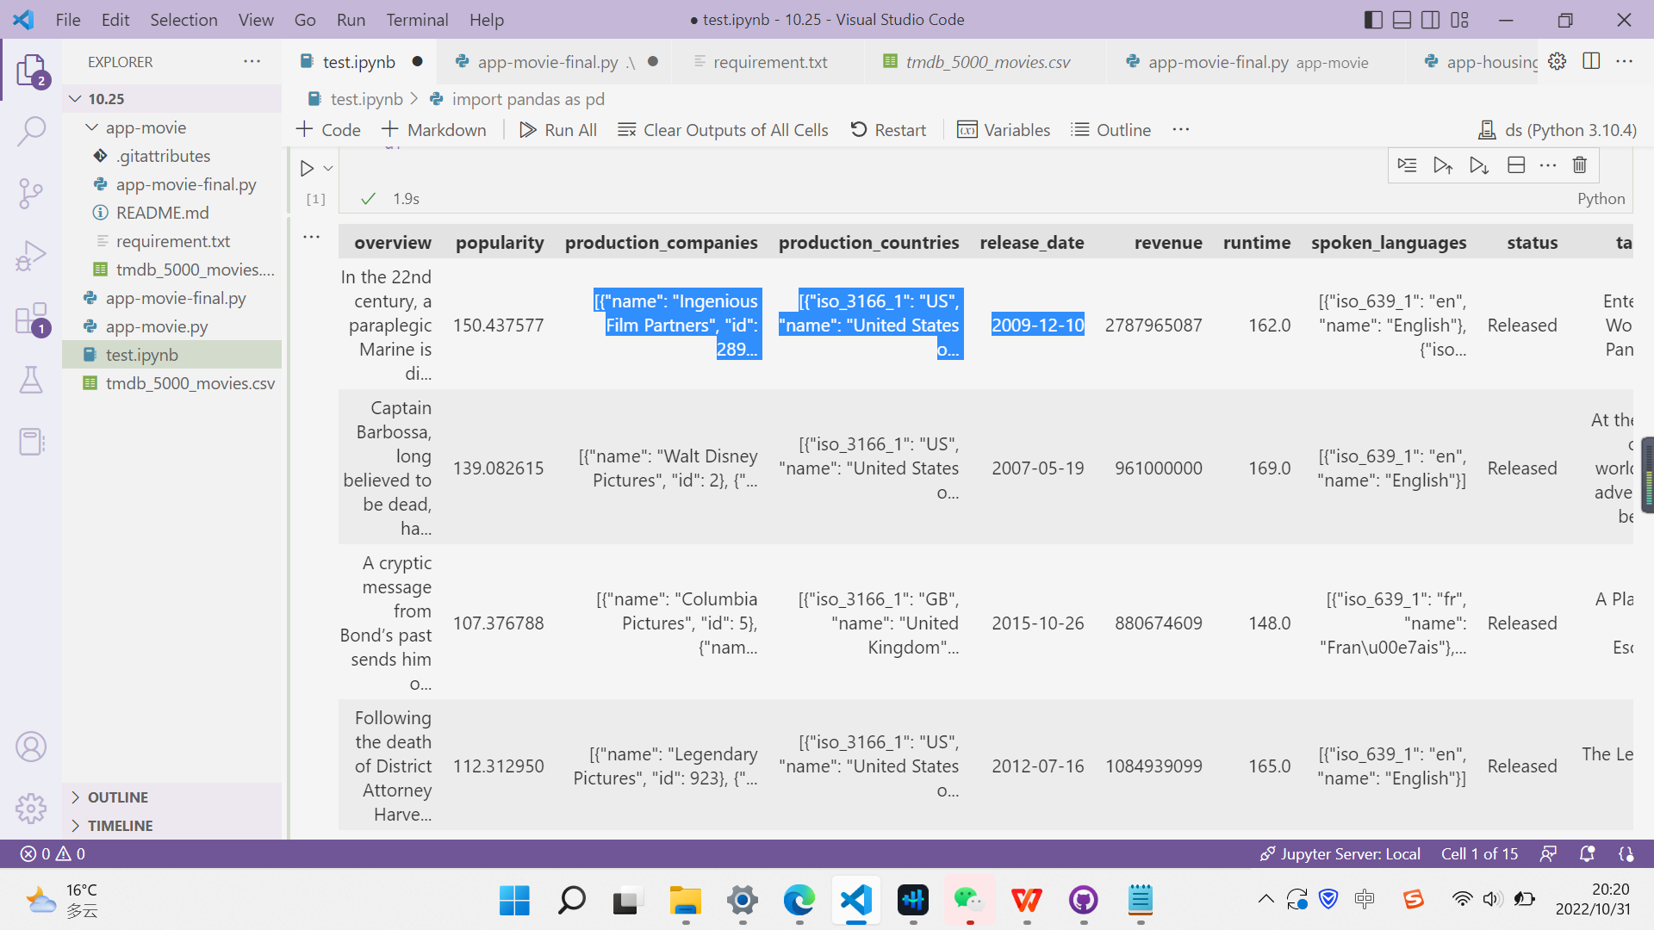
APP demo

Slide 20
Thanks

